Slide 1
Break It Up: A Teacher’s Guide to Managing Student Aggression Dr. Arnold Goldstein
Training School Psychologists to be Experts in Evidence Based Practices for Tertiary Students with Serious Emotional Disturbance/Behavior Disorders
James Knorr
1.12.2010
US Office of Education 84.325K
H325K080308

Slide 2
Program Description
Management of student’s aggression
Program based on preventing student’s oppositional behaviors
Based on 15 Levels of Aggressive Incidents
Physical Interventions viewed as the last form of intervention

Slide 3
Program Philosophy
Prevention is the first line of intervention
Create a climate of cooperation, collaboration, and respect
Establish rules and guidelines early with students
Teach rules and consequences, maintain them consistently
Establish an open communication between parents
“Catch it low, prevent it high”
Notes:
Rules should be posted in the class so all students can see the rules
Inform parents of the rules of the classroom
Phrase is important because most problem behaviors generally start out small and escalate into something greater

Slide 4
Program Philosophy
Physical Intervention should be the last line of intervention
Personal safety is the main concern for faculty
Faculty should establish a team management approach to handling incidents
All team members should receive training for the physical intervention
Physical intervention should be used ONLY if the student is, at the time, a danger to themselves, others, or property
Notes:
Each faculty member should assume specific roles within the team

Slide 5
Certification Requirements and Cost
Authors recommend intervention techniques should be used only by trained professionals
Training should be done with the crisis management team
Each member of the team should assume specific roles in managing the incident
No specific requirements to complete the training
Cost of the book on Amazon.com is $50.99

Slide 6
Training Outline
Competency is established by reviewing procedures in the book
Training should be done in a team format with the school’s individual crisis prevention team
Training should be supervised by the school’s administration
General plan should be reviewed with all school personnel working with students

Slide 7
Competencies
Staff should be adequately trained for their school position
Each member of the team should be comfortable carrying out their role in the team
Who is willing to get involved physically?
Who can prevent audiences from forming?
Designate one team leader
Notes:
Team leader is the most important in assessing the situation and regulating what should be done with the situation

Slide 8
Assessing/ Evaluating Progress
Assessing student’s behavioral progress is recommended
No guidelines are provided to assess progress

Slide 9
Legal Liability
No discussion is provided on the legal liability in using this management system
Notes:
Authors note that teachers willing to get involved should only do so when they feel they can appropriately handle the situation and that intervening will not cause them harm

Slide 10
Guidelines for Seclusion
Only recommended guidelines
Seclusion should be monitored at all times
Should be done away from other students
A staff member that has built trust with the student may provide support to better calm the student
Student should not return to the classroom until they are fully calm and the situation has been adequately evaluated

Slide 11
Prevention Interventions
Collaborate with student on rule creation at the beginning of the school year
Establishing and teaching rules should be done consistently for the first two weeks of school
Rules should be visible and developmentally appropriate
Consequences for breaking rules should be fair, appropriate and a punishment for the student
Notes:
Some consequences may not be punishers for all students

Slide 12
Prevention Interventions
Communication of rules and consequences should be made with parents
Establish contracts with both students and parents
Classroom environment should be created before school begins
Should be well lit
Easily visible from all areas
Should be open

Slide 13
15 Incident Categories
Horseplay
Generally starts as fun and then escalates
Rule Violation
“State the rule, state the consequence, consistently carry out the consequence”
“Catch them being good”
Disruptiveness
Exclusionary time-out
Inclusionary time-out
Notes:
Exclusionary time-out = taking the student away from the environment
Inclusionary time-out = leaving the student in the environment but no access to rewards

Slide 14
Categories cont’d
Refusal
“Consequate it immediately”
Cursing
Bullying
Most frequent form of student to student aggression
Bullies tend to be more aggressive and more impulsive
Sexual Harassment

Slide 15
Categories cont’d
Physical Threats
Vandalism
Window breaking is the most common
Most students are 11 to 16 years old
Vandals should be required to restore the environment
Out-of-control behavior
“Disruptiveness gone wrong”
Almost always require restraining student
Teachers that have trust with the student are more likely to calm the student

Slide 16
Categories cont’d
Fights
Most common times are during “transition periods”
Most common places are ones with less supervision
Attack on teachers
Group aggression
More common to have multiple fights occur simultaneous
Awareness of community events may lead to prevention
May be in the form of gang violence
Notes:
Fights are most likely to occur in hallways, outside, and after the student gets off the bus

Slide 17
Categories cont’d
Exemplars
Special Topics
Intruders
Weapons
Corporal Punishment
23 States still allow it
Authors view it as “unethical, ineffective, and inappropriate”

Slide 18
Physical Interventions
Utmost importance is for the faculty member’s safety
Use a team approach at all times
Training should be taken before any intervention
Faculty should perform four steps before intervening
Assess the scene
Use assertive verbal commands
Become committed to intervening
Determine what combatant to approach

Slide 19
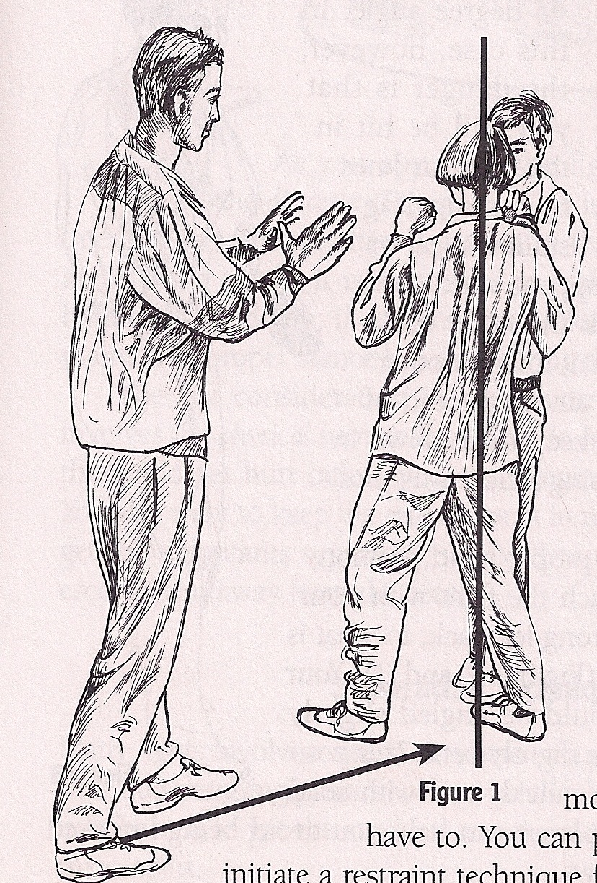
Techniques
Angle of Approach
45 degrees of fighter’s left or right side
Hands at shoulder level if combatants are standing up
Hands in a fist and around groin if combatants are on the ground
Approach with weak leg forward, knees bent

Slide 20
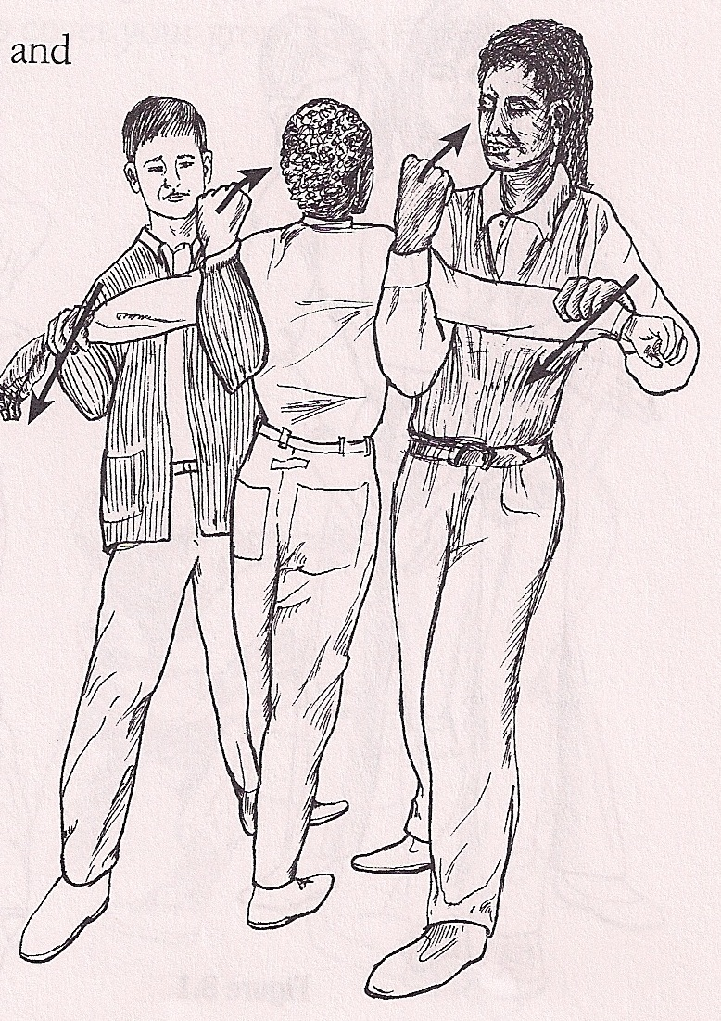
Separation Techniques
Techniques to be used when removing students from a fight
Finger Release
Grab, Smother, and Lift
Two-Person Arm Grab
Two-Person Arm Grab

Slide 21
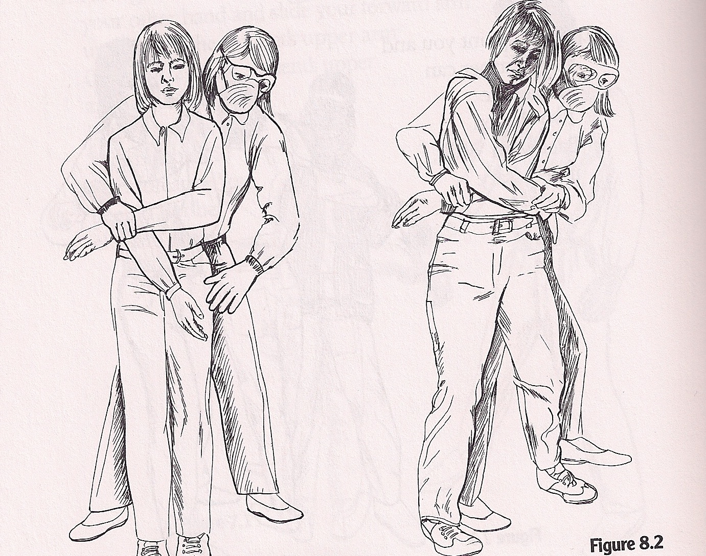
Separation Techniques
Crossed-Arm Pin
Four Person Pull Apart
Torso Shoulder Lock
Wall Pin
Crossed-Arm Pin

Slide 22
Restraint Levels
Specific set of techniques used to control students after they have been separated in a fight situation
Do not put weight on the chest!
Pain level of the student should be noted
Restraint should not be painful but used to control the student
Placing the child face-down is the best technique

Slide 23
Restraint Levels
Four Levels of Aggression
Low-Level Aggression
Place hand on student to not allow movement
Midlevel Aggression
Actively hold the student in a single-person restraint
High-Level Aggression
Multiple restrainers are needed
Extreme-Level Aggression
Multiple restrainers and active crowd control

Slide 24
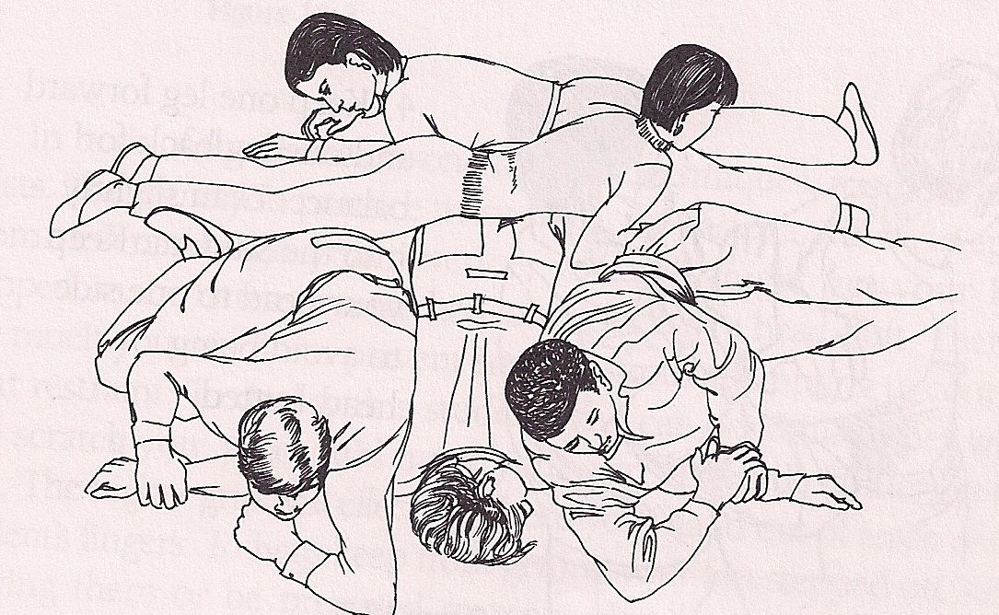
Extreme-Level Aggression
A high risk of other student’s involvement in the fight is present
A risk of other fights occurring is present
Crowd control should be used to calm other students and not allow potential involvement from occurring
Potential Extreme-Level Aggression Restraint

Slide 25
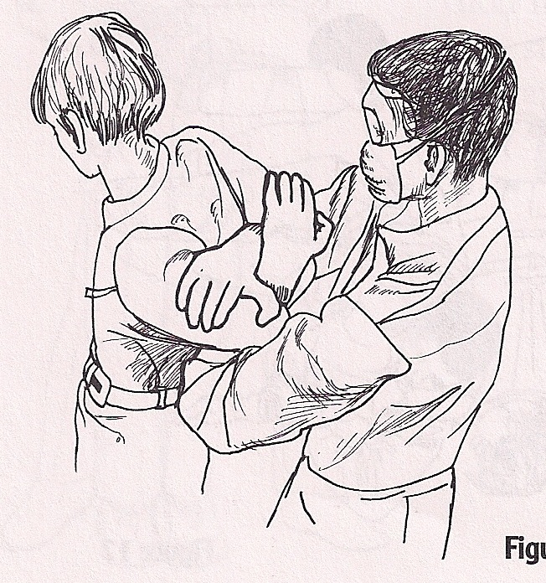
Restraint Techniques
Standing-Arm Techniques (Midlevel Aggression)
Triceps Lock
Double Arm Lock
Triceps Lock
Notes:
Restraining techniques are used to not allow a student access to the situation in which they needed to be removed from
Important to note that airway is always free from obstruction

Slide 26
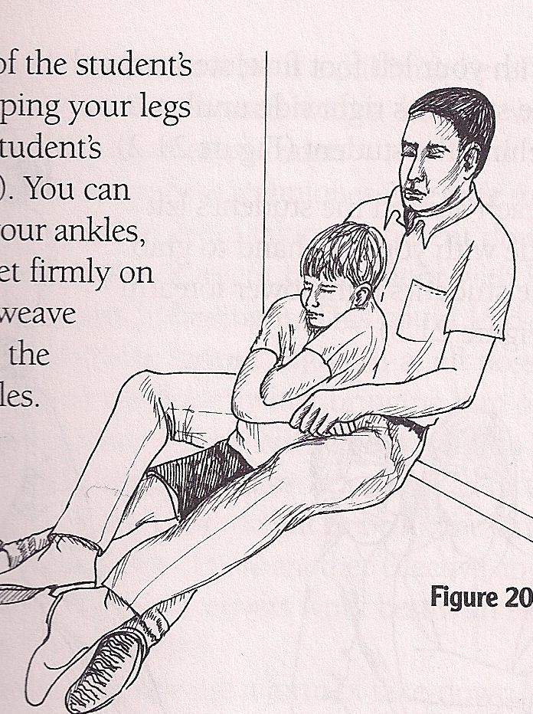
Restraint Techniques
Crossed-Arm Techniques (High-Level Aggression)
Sitting Crossed-Arm
Standing Crossed-Arm
Sitting Crossed-Arm

Slide 27
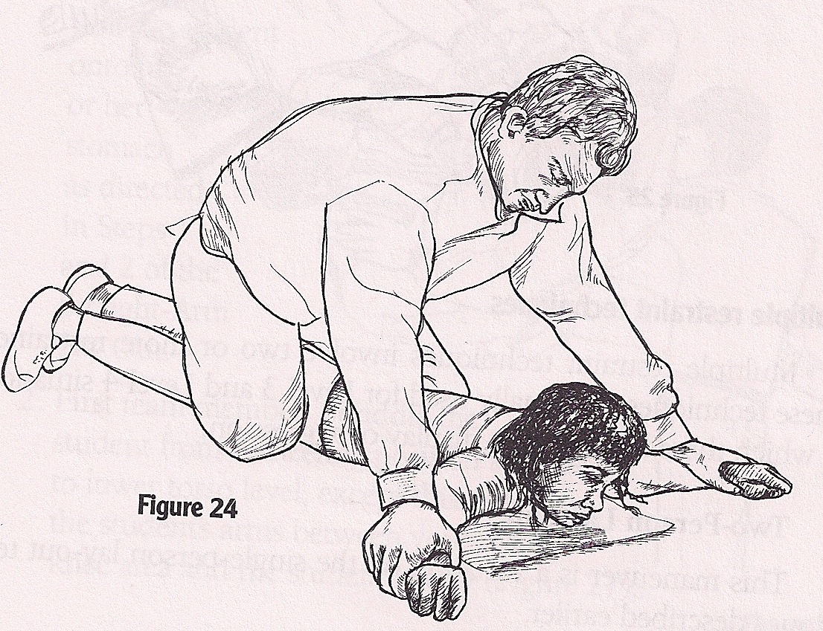
Restraint Techniques
Lay-Out Techniques (High-Level Aggression)
Leg Block
Straight-Arm Lay Out
Extended-Arm Lay Out
Scissor Lay Out
Extended-Arm Lay Out
Notes:
Important note is that no weight is being placed on the student’s chest

Slide 28
Multiple Restraint Techniques
Usually with High/Extreme-Level Aggression
Two or more restrainers
Two-Person Lay Out
Three-Person Lay Out
Four-Person Lay Out
Rollover
Four-Person Lay Out

Slide 29
Release Techniques
Team Communication
The best communicator with the student will be the person with the best rapport with the student
Release Decision
Release Parameters
Notes:
Release decision should be given by someone who is retraining the individual because they can gauge the level of intensity of the student
Release parameters should be away from the situation
Releasing can be done simultaneously or one restrainer at a time

Slide 30
Escort Techniques
Two Types of Escorts
Controlled Escort
Requires hands on the student
Two-Arm Walk
Single-Arm Escort
Two-Person Backward Walk
Supervised Escort
Not required to have hands on the student
Escorts to remain outside of the student’s striking zone

Slide 31
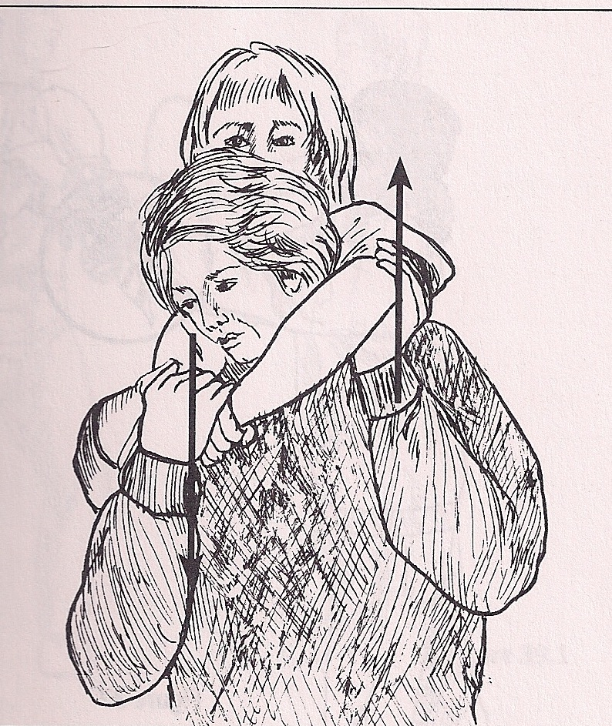
Personal Safety
Escape Techniques
Head Lock
Grab The Tie
Wrist Grabs
Sustained Biting
Bear Hugs
Head Lock
Notes:
Ways of escaping a hold from a student

Slide 32
Safety cont’d
Avoiding Incoming Strikes
Focus attention on the striker’s hip region
Watch for telegraphed movements
Inward/Outward/Upward/Downward Blocks
Jamming/Smothering

Slide 33
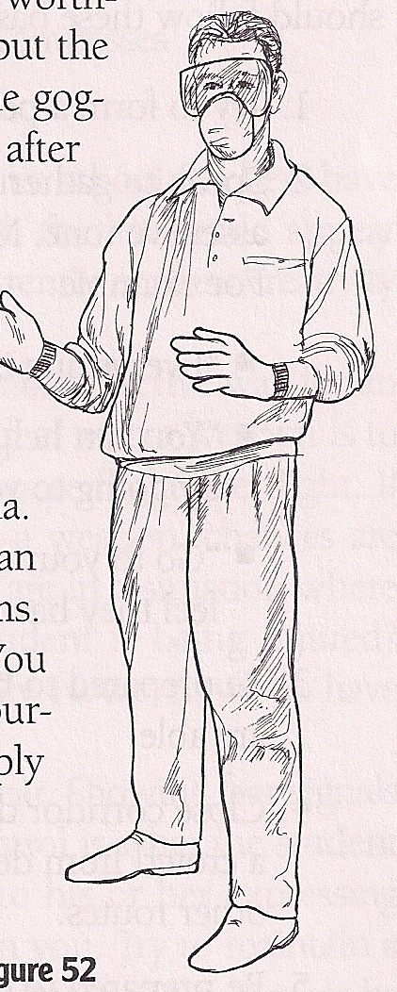
Safety cont’d
Fight Kits
Degree of protection against blood-borne diseases
Latex Gloves
Goggles
Surgical Masks
Antiseptic Wipes
Bleach/Water Solution

Slide 34
Safety cont’d
Crowd Control
Prevention by informing student’s about fight management
Block the student’s path/view
Dealing With Weapons
Do not confront a student with a weapon
Use jamming/smothering techniques as a last resort
Perimeter and Area Control

Slide 35
Media Support
There is no supporting material for this guide
Dr. Arnold P. Goldstein narrated a video, “Break It Up: Managing Students Fights,” which details fight management skills

Slide 36
Research?
The procedures and techniques described in book result from an analysis of 1,000 episodes of low-, medium-, and high-level aggression across the United States
From Elementary, Middle, Senior High School teachers in urban, rural, and suburban school districts
No further research was found on the efficacy of the program

