Slide 1
Radical Raceway
Training School Psychologists to be Experts in Evidence Based Practices for Tertiary Students with Serious Emotional Disturbance/Behavior Disorders
James Knorr
3.17.2010
US Office of Education 84.325K
H325K080308

Slide 2
What is Radical Raceway?
An interdependent group contingency intervention to help improve completion and accuracy of homework
Involves mystery motivators and progress monitoring
Uses racing as a way to motivate students
Used for class subjects which students are struggling to complete their homework accurately
Notes:
2) Two types of mystery motivators: a small reinforcement and a large reinforcement
3) Racing is used due to the increasing popularity of Nascar and the movie Cars
4) Should not be used with students who cannot complete the homework due to lacking skill

Slide 3
Rationale
Axelrod (2009) defines homework as tasks that teachers assign students outside of the school and can serve many purposes, including developing self-discipline, organization skills and provide repetition of skills that were learned during the school day.
Not completing homework can often disrupt classroom routines. Establishing classroom routines is a key component for preventing disruptive behavior from occurring in the classroom (Bowen, 2004).
Because these skills can be necessary in future daily living, it is important that students correctly complete homework on a regular basis.
Radical Raceway is class-wide homework intervention program targeted to improve homework completion and homework accuracy.

Slide 4
Materials to be Used?
Mystery Motivators
Racecar Reward Sheet
Crayola Color Changeables™ Markers
Rockin’ Racecars
Student/Team Progress Tracking Sheet
Radical Raceway

Slide 5
For Whom?
Radical Raceway is an intervention which all students in a classroom can participate
Teachers can use it for a range of subjects
Math
Reading
Writing
Spelling
Grade Pre-K through 8th Grade
Notes:
1) Important to include all students in a classroom so everyone has an equal opportunity to earn a reward
2) Any subject that can be graded by percentage (not pass/fail)
3) Using 8th grade as a max due to limited interest in high school years

Slide 6
Mystery Motivators
Envelope placed in front of the class
Write the small/large prize on a slip of paper and place it in the envelope
???
Notes:
Indicate which envelope is the small/large mystery motivator
Uses a larger envelope for the larger reinforcer

Slide 7
Racecar Reward Sheets
Notes:
Indicators are invisible to students until they color in the box

Slide 8
Racecar Reward Sheet
Students are allowed to color in squares based on completion and accuracy of their homework
A set criterion of accuracy for the class should be randomly assigned each week
A comment section provides parents with feedback on how their child is doing with their homework
Mystery Motivator indicators are randomly placed in squares by the teacher at the start of the week
Notes:
1.1) The set criterion of accuracy should be kept secret from the students
2) Feedback to parents should always be positive
3) Randomizing will keep rewards on a variable ratio schedule

Slide 9
Racecar Reward Sheet
As students start consistently completing their homework accurately, the number of indicators should be reduced for the week
Students receive a small mystery motivator if they have an “M” in the square they color in
Notes:
1) The number of indicators for each student should be based upon the tracking system included in the intervention
2) Students can be named “Racers of the Day”

Slide 10
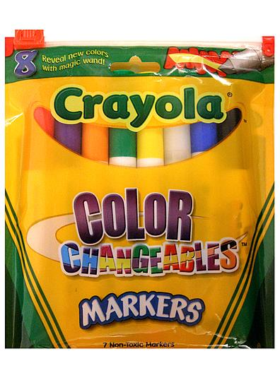
Crayola Color Changeables™ Markers
Invisible Ink Markers
Teacher randomly puts M’s (invisible ink) in boxes to use as mystery motivator indicators
Teacher should place more M’s in the boxes for student’s struggling with homework
Struggling students should have 1 M box for every 3 blank boxes
Notes:
3) The number of indicators should be thinned based on student performance
3.1) Students excelling should receive 1 or 2 M’s per week

Slide 11
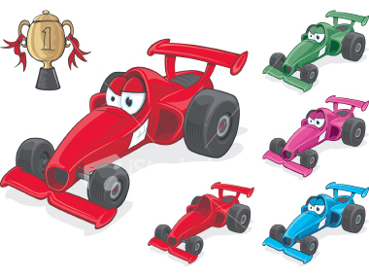
Rockin’ Racecars

Slide 12
Rockin’ Racecars
Students are divided into equal number of teams
Have a maximum of 5 teams
Team racecars are displayed on the Radical Raceway
Teams compete against each other to reach the finish line of the racetrack
Notes:
4) Racecars have Velcro on the back to allow easy movement along the racetrack

Slide 13
Progress Tracking Sheet
Progress Sheet

Slide 14
Progress Sheet
Gives teachers an easy tracker of each student’s progress throughout the week
Easy calculation of team averages
Color coded by team
Easy to add new teams/students

Slide 15
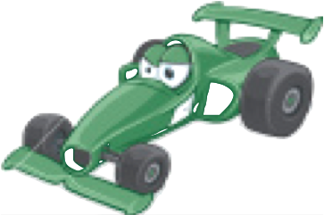
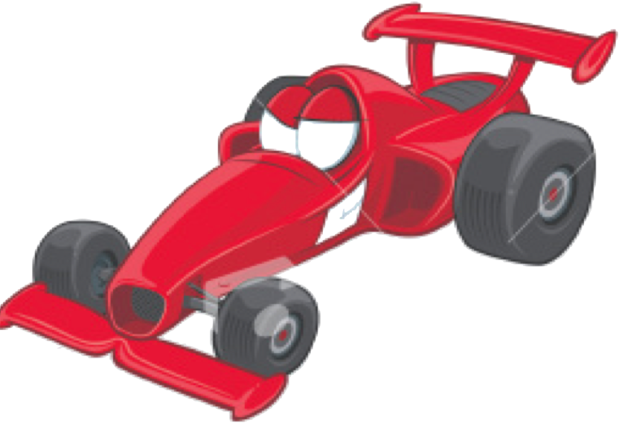
Radical Raceway
Displayed so all students can see their team’s progress
Goal is to be the first team to reach the finish line
Notes:
Velcro used to attach cars to points on the course

Slide 16
Radical Raceway
One car is able to move a day
Cars progress based on the highest team average
Number of progressions needed to reach finish line is determined by the teacher
Minimum should be at least 5
Maximum should be at most 15
Students on the winning team receive a large Mystery Motivator
If the race is a tie, both teams receive the large reward
Team members change once the race has been won
Notes:
3) Minimum criteria should be used with students who are struggling with homework
3) Maximum criteria should be used with students who are doing well on homework
6) Members of the team should be picked at random if all students are doing well or pairing struggling students with excelling students

Slide 17
Small Mystery Motivator Ideas
Piece of candy
Tell a joke to the class
Free problem on next homework
Read aloud to the class
First in line to recess/lunch/home
Stickers
Good note home
Indicating they are one of the “Racers of the Day”
Notes:
1) These should be varied each day using a variety of reinforcers!

Slide 18
Large Mystery Motivator Ideas
Extra recess time
Free homework pass
Lunch with the teacher
Class presentation
Show-and-Tell
Large candy
Notes:
4) Class skit or comedy show

Slide 19
Making Radical Raceway Better!
Make a game out of guessing what the mystery motivator is
Monitor student’s wants to provide for effective motivators
Allow teams to create their own car and name it
Build anticipation for the race
Collect homework at the beginning of the day; results at the end of the day
Combine with point/lottery system
Allow sampling of the reinforcers
Notes:
2) Allow students to effect what rewards are given by giving questionnaires on what the students want or by keeping track of what students ask for
6) Mrs. Smith’s homemade cookies!

Slide 20
Troubleshooting Radical Raceway
Student does not want to participate
Inform them that non-participation is OK but they will lose out on possible rewards
Student does not bring back homework/sabotages team
Place the saboteur on their own team
Allow the saboteur to create their own car
Allow the saboteur to move the racecars for each day
Student complains about the reward
Explain to students before implementing intervention that complaining will result in a loss of the reward
Notes:
1) Allow student to identify reinforcers they want to be included as a mystery motivators
2) Get them more involved
3) Students do not get to pick the reward

Slide 21
Troubleshooting…
Student tries to color in multiple boxes
Make the mystery motivator indicator small the box
If behavior reoccurs, suspend the program for the individual
Student loses their Racecar Reward sheet
Before implementing the intervention, explain a penalty clause for losing one’s mystery motivator sheet
Notes:
2) Possible penalties can include losing the further opportunities for the remainder of the week

Slide 22
Cautions
Inform parents of the intervention
Be aware of possible food allergies
Students in other classes become upset
Notes:
2) Allow for an alternative reward for food allergies
3) Provide rewards at the end of the day and review guidelines for rewards (students need to put reward in their backpack and not to bring them out until they get home)

Slide 23
Evidence-Based Practice
While no research has been conducted on the effectiveness of Radical Raceway, there is a significant body of research that supports the principles and components upon which Radical Raceway was constructed.
Radical raceway incorporates group contingencies, public posting, mystery motivators, variable reinforcement schedules, and positive reinforcement strategies into a single intervention.

Slide 24
EBP: Group Contingencies
A group contingency is a situation in which the performance of one or more individual affects the outcome for other individuals.
Radical Raceway incorporates an interdependent group contingency for students to receive rewards.
This is a strategy in which consequences are contingent upon the entire group making a certain criteria.
Skinner et al. (2004) found that grouping students and having consequences given interdependently among groups has successfully be used to enhance student academic performance.
In Stage and Quiroz’s (1997) meta-analytic study of interventions to decrease classroom disruptive behaviors, they found that group contingencies had the highest effect size for reducing problem behaviors in the classroom, when compared to all other interventions incorporated into the meta-analysis (-1.02).

Slide 25
EBP: Public Posting
Public posting is the acknowledgement of an individual’s or group’s performance in a place where it can be observed by others.
Jones and Van Houten (1985) showed that public posting was an integrated part of an intervention that reduced disruptive behaviors and improved academic outcomes for secondary students.

Slide 26
EBP: Mystery Motivators
A mystery motivator is an unknown, high-value, contingent reward.
Creates a sense of anticipation due to its secrecy.
Moore and Waguespack (2004) suggest that mystery motivators are an effective, socially valid intervention that can be implemented in the classroom with integrity.
In Jennifer Hoag’s dissertation (2007) of the effects of mystery motivators as compared to expected reinforcers, she found that mystery motivators were more effective than expected reinforcers at reducing disruptive behaviors among preschool students.

Slide 27
EBP: Variable Reinforcement Schedule
When a student has access to a reward randomly, rather than expectedly, they are on a variable reinforcement schedule.
Ferster and Skinner (1957) described this schedule of reinforcement as the most reinforcing schedule when compared to other schedules of reinforcement (continuous, intermittent).
Beaman et al. (1983) found that behaviors placed on a variable reinforcement schedule were more resistant to extinction than behaviors placed on a regular schedule of reinforcement.

Slide 28
EBP: Positive Reinforcement
Positive reinforcement is the act of rewarding a student for correct behavior by giving the student something they find to be rewarding.
By rewarding the student, the behavior subsequently increases in order to receive more reinforcement.
Positive reinforcement can come in many different entities such as praise or intrinsic rewards.
Stage and Quiroz’s (1997) meta-analytic study of intervention to decrease classroom disruptive behaviors found reinforcement to have a large effect in reducing disruptive classroom behaviors.
They found mean effect size of -.86 for the studies included in their meta-analysis.

Slide 29
Let’s Go Racing!

Slide 30
References
Axelrod, M. I., Zhe, E. J., Haugen, K. A., Klein, J. A., (2009). Self-management of on-task homework behavior: A promising strategy for adolescents with attention and behavior problems. School Psychology Review, 38 (3), 325-333.
Beaman, A. L., Stoffer, G. R., Woods, A., Stoffer, J. E., (1983). The importance of reinforcement schedules on the development and maintenance of altruistic behaviors. Academy Psychology Bulletin, 5 (2), 309-317.
Bowen, J., Jenson, W. R., Clark, E., (2004). School-based interventions for students with behavior problems. New York, NY: Kluwer Academic/Plenum Publishers
Ferster, C. B., Skinner, B. F., (1957). Schedules of Reinforcement. New York: Appleton-Crofts.
Hoag, J., (2007). Effects of mystery motivators vs. expected reinforcers on disruptive behavior in preschoolers. Dissertation Abstracts International: Section B: The Sciences of Engineering, 67 (10-B).

Slide 31
References cont’d
Jones, D. B., Van Houten, R., (1985). The use of daily quizzes and public posting to decrease the disruptive behavior of secondary school students. Education and Treatment of Children, 8 (4), 91-106.
Moore, L. A., Waguespack, A., (1994). Mystery Motivator: An effective and time efficient intervention. School Psychology Review, 23 (1), 106-118.
Skinner, C.H., Williams, R.L., Neddenriep, C.E., (2004). Using interdependent group-oriented reinforcement to enhance academic performance in general education classrooms. School Psychology Review, 33 (3), 384-397.
Stage, S. A., Quiroz, D. R., (1997). A meta-analysis of interventions to decrease disruptive classroom behavior public education settings. School Psychology Review, 26 (3), 333-368.

